Slide 1


Minor Project 2078
Search
Smart Attendance

Slide 2

False Attendance
We have encountered it many time that students not physically present in the classroom make their friends to do their attendance
Problem Statement

Slide 3



Digitalize Attendance System
Face Recognition Attendance
Capture realtime image

Slide 4


Make attendance system digital
Our Objective
Provide a teacher and student app to initiate and take attendance
A server system that can retrieve attendance of a particular class in a specific subject over a specified time frame
How we solve attendance problem
A attendance code that can tries to stop the problem of false attendance

Slide 5
System Workflow

Slide 6
Attendance
Database
Attendance Server
Teacher App
Student App
Teacher initiates attendance by requesting server for a unique attendance code

Slide 7

Teacher
Requests the server to start the attendance
Provides server generated attendance code to students
Updates attendance list of students
Is able to mark students present
Stops the attendance process

Slide 8
Student
Join attendance after using given code by the teacher
Presence done by click of a button
Almost instant feedback of face recognition presence status
Sends face embedding to the server for attendance

Slide 9
Server
Handles requests with LAN
Generates unique attendance code for an instance of attendance
Handles the face recognition part for presence
Timeout attendance in 10 minutes
Protects data of database

Slide 10
Web App
Provide a time period based list for each class for a given subject
List can be downloaded in excel format
Mobile friendly interface

Slide 11
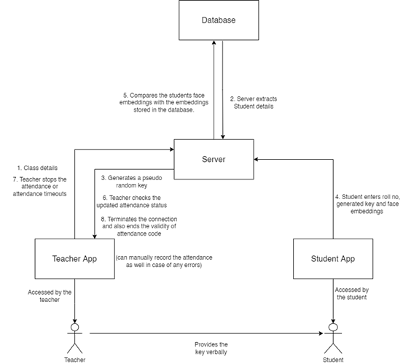

Slide 12
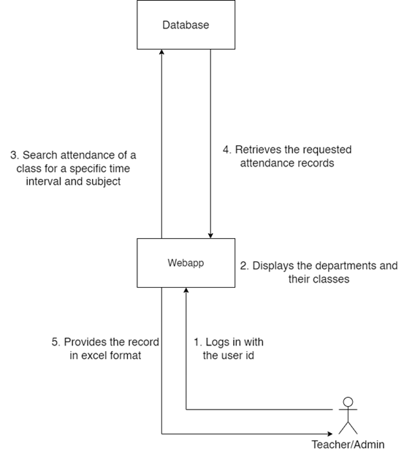

Slide 13
Components
Used

Slide 14
For Student and Teacher Apps
Python as our base language
Kivy, framework in python used for app development from python scripts

Slide 15
For Server
Socket based connections
Separate connection point for student and teacher clients
Request-response based approach
Multithreading for each client connection
A separate thread to handle attendance timeout
Student verification and attendance
Database access only in server

Slide 16
For WebApp
MySQL for database
Html and CSS for design of the front-end of the webapp
PHP and Javascript for communication with the database

Slide 17

QR code instead of text for attendance code
Android and IOS stable mobile application
Future Enhancements

Slide 18

Thank you!
Now for the demo part

